Slide 1

Network Analysis Nation’s Position in International System: Block Model Approach
Dhruval Bhatt
December 9th, 2019

Slide 2
Objective & Agenda
Purpose: To model a study after Ronald Breiger’s work on “Structures of Economic Interdependence Among Nations” from the book, Continuities in Structural Inquiry for understanding network analysis for international trade.
Question: What is the positions of nations in the international system in 2008 and 2018 based on simultaneous exchange of different economic goods and CONCOR model?
Agenda
Background & Theory
Data
Analysis
Results
Conclusions

Slide 3
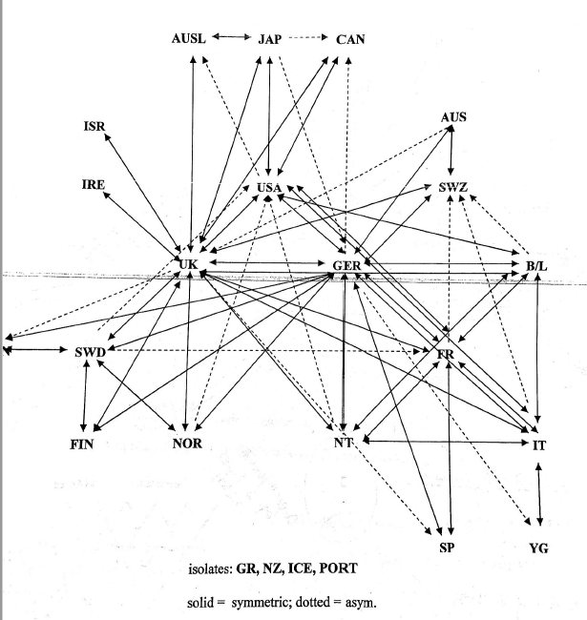
Background
Brieger 1981 Study renewed structuralist perspective to patterns in world economy
Based on the World System Theory and trade data for OECD countries in 1972 to:
Develop an operational procedure to identify core, peripheral and semi peripheral states on the basis of structural positions they occupy in international exchange networks
Distinctive elements of a core-periphery structure in contrast to other ideal-type structures
Difference and interlocks in patterns among different exchange types – capital flows, trade in manufactures, trade in foodstuff, military interventions
Determine in what sense are core-periphery structures monolithic and to what extent do they allow for multiple competing centers
CONCOR block Modeling:
Iterates correlations among columns of R
Splits the matrix into two structural equivalence blocks
Resulting Network Diagram for 1971 OECD data [from Dr. Padgett’s Notes]
Japan
USA
UK
G
Sweden
France
Japan
USA, UK, G
Sweden
France
Notes:
Immanuel Wallerstein’s theory:

Slide 4
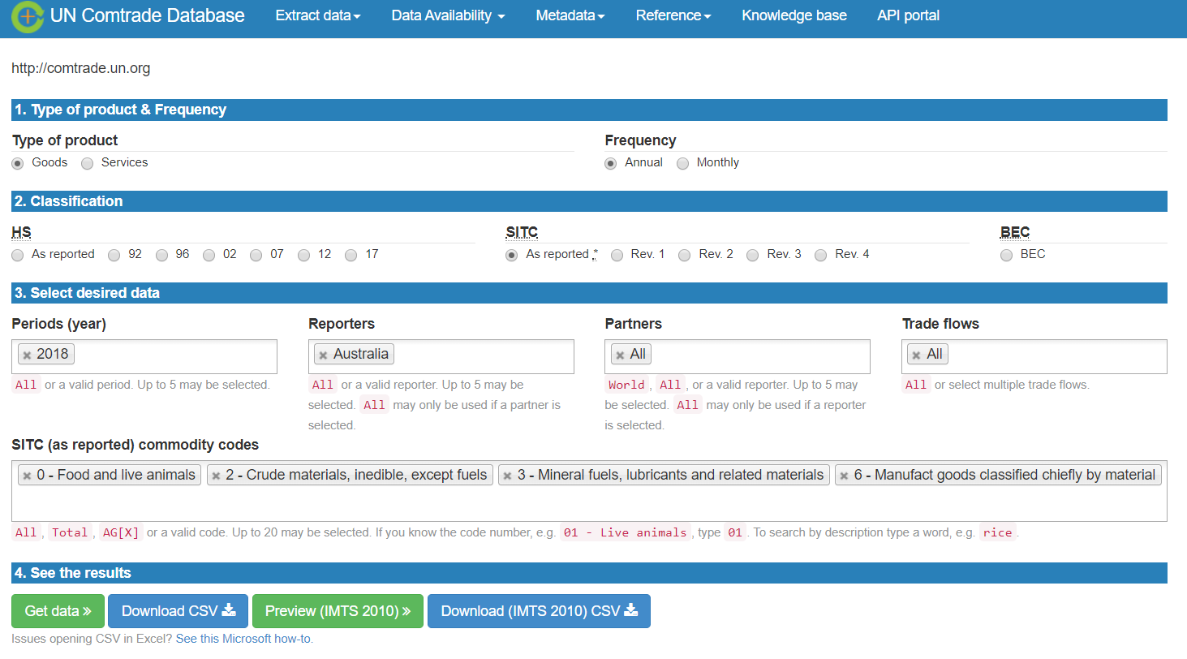
Data
Data is collected from UN Comtrade Database
The following data is downloaded:
Import/Export for same commodities that breiger considered for Year 2018 and 2008 for all countries in OECD + India, China, Brazil (ICB)
Goods trade for China for years: 2008 – 2010
Data is processed using Pandas in python to:
Remove countries that are not in OECD or India, China Brazil
Create n by n adjacency matrix for countries for block modeling
Only consider 5th of the volume
Create edgelist for China to conduct ego centric analysis

Slide 5
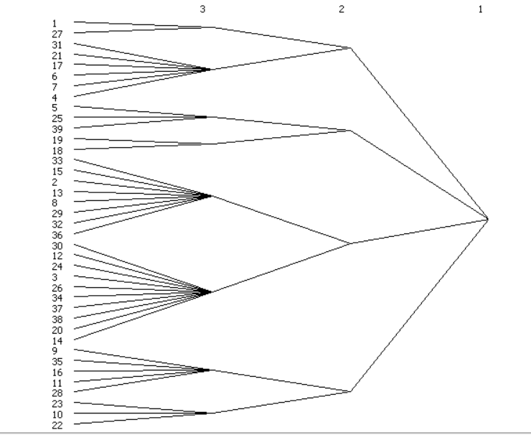
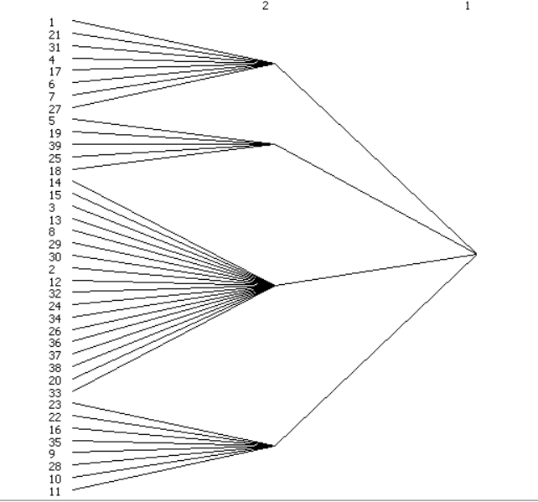
CONCOR: 2018 OECD + India, China, Brazil
Notes:
Additional levels made it lose meaning

Slide 6
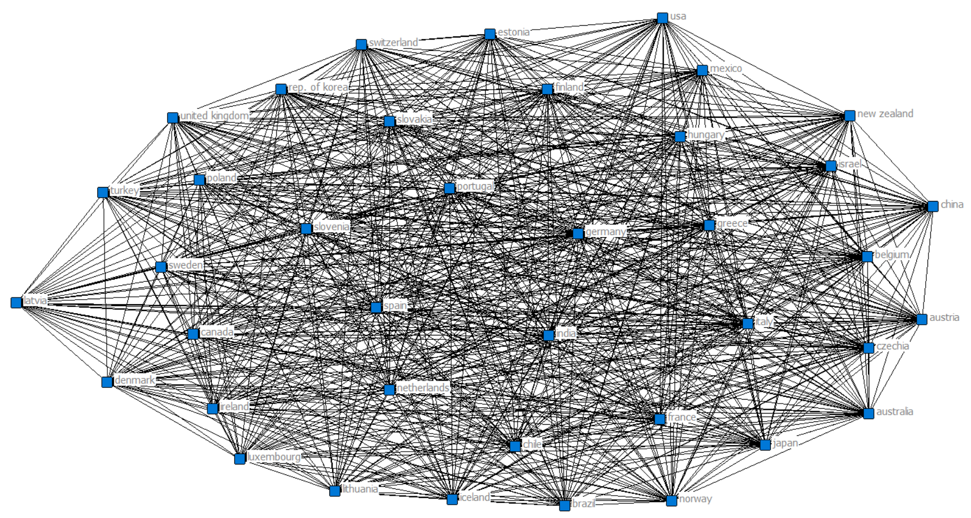
Notes:
Concor 1sr correlation

Slide 7
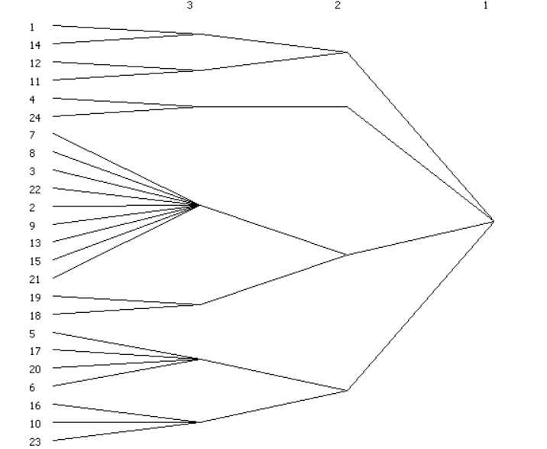
CONCOR: 2018 Data for 1972 OECD + Israel

Slide 8
Country List and Code Description
COUNTRY | YEAR OF ACCESSION
AUSTRIA | 1961
BELGIUM | 1961
CANADA | 1961
DENMARK | 1961
FRANCE | 1961
GERMANY | 1961
GREECE | 1961
ICELAND | 1961
IRELAND | 1961
LUXEMBOURG | 1961
NETHERLANDS | 1961
NORWAY | 1961
PORTUGAL | 1961
SPAIN | 1961
SWEDEN | 1961
SWITZERLAND | 1961
TURKEY | 1961
UNITED KINGDOM | 1961
UNITED STATES | 1961
ITALY | 1962
JAPAN | 1964
FINLAND | 1969
AUSTRALIA | 1971
NEW ZEALAND | 1973
MEXICO | 1994
CZECHIA | 1995
HUNGARY | 1996
KOREA | 1996
POLAND | 1996
SLOVAKIA | 2000
CHILE | 2010
ESTONIA | 2010
ISRAEL | 2010
SLOVENIA | 2010
LATVIA | 2016
LITHUANIA | 2018
BRAZIL | Not OECD
CHINA | Not OECD
INDIA | Not OECD
Code | Description
0 | Food and Live Animals
2 | Crude materials, inedible, except fuels
3 | Mineral fuels, lubricants and related material
6 | Manufactured goods classified by material

Slide 9
Network Diagram from Dr. Padgett’s Notes
Japan
USA
UK
G
Sweden
France
Japan
USA, UK, G
Sweden
France

